Slide 1
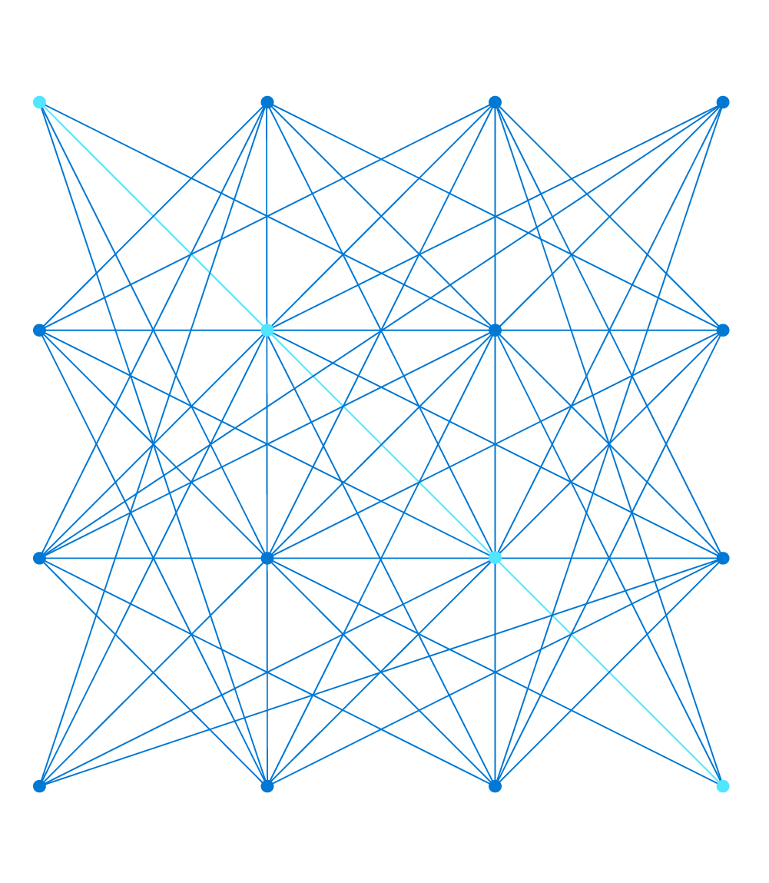
AI-900 Azure AI Fundamentals
Notes:
Before You Start Teaching this Class
Make sure you read the Trainer Preparation Guide for this course – it contains important tips and suggestions to help you deliver the course successfully.
In particular, we recommend that trainers delivering this class complete all of the online learning paths listed at https://docs.microsoft.com/learn/certifications/azure-ai-fundamentals, including the hands-on exercises. This will give you a broader view of the key topics in this course than reviewing the course materials alone.
Before the start of a delivery, complete the online exercises so that you have a working Azure Machine Learning workspace environment with the exercise solutions in-place and ready to demonstrate. This will help you add context to some of the topics where time doesn't permit a hands-on lab during the classroom delivery; and help reinforce the blended nature of this course and the related learning paths on Microsoft Learn.

Slide 2

About this Course
Course format:
One-day instructor-led with hands-on exercises
Supplemented by online training - See the full list of online learning paths at:
https://docs.microsoft.com/learn/certifications/azure-ai-fundamentals
Course Objectives
Describe Artificial Intelligence workloads and considerations
Describe fundamental principles of machine learning on Azure
Describe features of computer vision workloads on Azure
Describe features of Natural Language Processing (NLP) workloads on Azure
Describe features of conversational AI workloads on Azure
Notes:
This course is designed to be delivered as part of a blended curriculum with associated online modules on Microsoft Learn. The course will cover all of the key learning objectives for the associated certification exam; but encourage students to take a deeper dive into the online modules on Microsoft Learn to get more hands-on experience with the technologies and additional insights into building AI solutions on Azure. Think of this course as a college lecture, and the modules on Learn as the course textbook.
Show students the Azure AI Fundamentals certification page at https://docs.microsoft.com/learn/certifications/azure-ai-fundamentals, pointing out the five online learning paths listed there. These learning paths map to the five modules in this one-day course and provide opportunities for further exploration and hands-on activities that supplement the classroom experience today.
Throughout the course materials, there are links to the related modules on Learn. You may need to explain the overall structure of the content on Learn:
The certification landing page lists five learning paths. These map to the five modules in this one-day course.
Each learning path contains one or more modules. These reflect important topics within the areas covered by the learning paths – they don’t necessarily correspond 1:1 with the lessons or slides in this course, but they elaborate on the topics we'll cover in the class
Each module includes individual units, some of which include hands-on exercises. We'll explore some of these hands-on exercises during today's class, and students can explore the others at their leisure after the course.

Slide 3
Course Agenda
Modules
Module 1: Introduction to AI
Module 2: Machine Learning
Module 3: Computer Vision
Module 4: Natural Language Processing
Module 5: Conversational AI
Notes:
The course consists of five modules. When delivered as a 1-day course, modules 1 and 2 are generally covered in the morning, and the remaining modules in the afternoon – though timings may vary depending on local factors.

Slide 4
Preparing for the Labs
You will need:
A modern web browser (for example, Microsoft Edge)
The hosted environment provided by your Authorized Lab Host.
Activate your Azure Pass subscription:
Go to https://live.com and sign in using a personal Microsoft account
For example, an outlook.com account. If you don't have one, create one
After signing in, go to https://www.microsoftazurepass.com
Start the process to activate an Azure Pass
Enter the promo code provided for this course and activate the subscription
Verify you can sign into the Azure portal at https://portal.azure.com
Notes:
This course emphasizes hands-on experiences with Microsoft Azure services for AI. To support this, students will need a Microsoft Azure Subscription
Students should have received a promo code for an Azure pass when they registered for the course. This Azure pass provides restricted access to Azure services for a limited time. Students must activate their Azure pass subscription using a Microsoft account. You can create a Microsoft account with a new email address or use an existing email address from a third-party email account, such as Gmail or Yahoo. If students don't already have a Microsoft account, they can sign up for one at https://live.com.
It is recommended that students do not associate a corporate or school account with an Azure pass subscription. Additionally, we encourage students to use a fresh Azure Pass subscription in preference to their own personal, work, or school Azure subscription. Some resources used in this course are subject to quota restrictions, which may limit students' ability to complete the labs successfully.
If students have an existing Azure subscription, they may find that credential caching prevents them logging in with the credentials associated with their Azure Pass subscription. In this scenario, encourage students to try using an InPrivate/Incognito browser session.
Update: Hosted Environment
The labs in the course are now provided on a hosted environment. MCTs will need to contact their Learning Partners for the links. ATTs will find five lab links instead of one in the ESI Lab On Demand course portal. Please review the change log (February 2021) for details.

Slide 5
Online Role-based training resources: Microsoft Learn https://docs.microsoft.com/learn/
Notes:
Encourage the class to go now and sign into Microsoft Learn, and explore the site if they have not visited it before. Encourage students to sign in so they can bookmark courses or learning paths that interest them, track module completion, and earn points.
Then review the learning paths associated with this course at https://docs.microsoft.com/learn/certifications/azure-ai-fundamentals.

